Slide 1

Vegas Hacker Camp
Hritesh Sonawane​

Slide 2
Quiz yay!
In the TV series "Mr. Robot," the main character Elliot Alderson is a brilliant hacker. What unusual pet does Elliot have, which he refers to as his "only friend"?

Slide 3
Quiz yay!
In the movie, “The Social Network," which character famously said, "A million dollars isn't cool. You know what's cool? A billion dollars."?

Slide 4
Quiz yay!
In "Mr. Robot," what is the name of the hacking group led by Elliot Alderson that aims to take down corrupt corporations and the financial system?

Slide 5
Quiz yay!
In the movie, "The Social Network," what algorithm, initially used to create a Harvard-specific social network, later became a critical component of Facebook's success?

Slide 6


Agenda
A
Introduction – Not a tech talk
Cybersecurity Conferences
Blackhat USA
DEF CON
Q&A

Slide 7
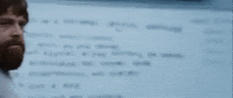
Introductions

Slide 8


Cybersecurity Conferences

Slide 9
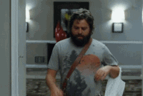
Why you should NOT go
Imposter syndrome
The talks look ✨amazing✨
If you pay full-price
You’re an introvert
If you think you know EVERYTHING to know in your area of expertise

Slide 10

Why you SHOULD go
Imposter syndrome
Free alcohol
Legendary parties
To meet people who love security, not for NETWORKING
See for yourself, how cybersecurity, is the BIGGEST close-knit community

Slide 11
https://www.youtube.com/watch?v=QGrjdISbc6Y
Stay hydrated

Slide 12
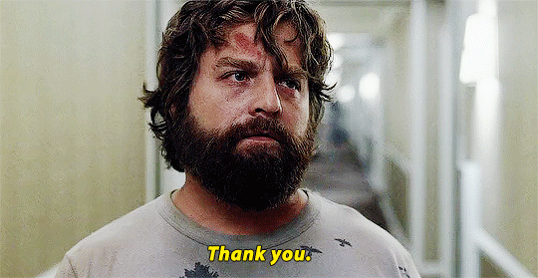
Tips
Pre-plan
Have a plan
Have a plan B
Choose your poison
Don’t see your friends 9am-5pm
Hack the shit out of Vegas (social engineer EVERYTHING)

Slide 13
We are all going to fucking wake up on Mars this Monday.
“
”
Fast Oran

Slide 14
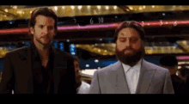
Blackhat USA = Swags

Slide 15
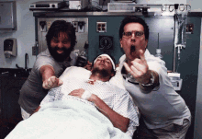
DEF CON = Legendary

Slide 16
Thank You

